Slide 1
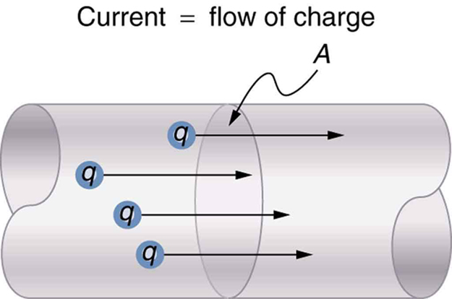
Current and Circuit Diagrams

Slide 2
What is current?
When matter has an unequal number of protons (+) and electrons (-) it becomes charged. Two objects of different charge that come into contact with one another will cause a flow of charge known as current.

Slide 3
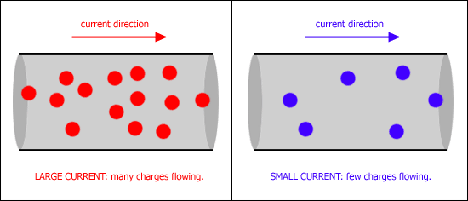
Current is the rate of flow of electrical charge and is measured the unit ampere (A) or amp.

Slide 4
Current always flows from a positively charged source to a negatively charged source.
+ → -
However, electrons always flow from negative (high concentration of electrons) to positive (low concentration of electrons).
- → +

Slide 5
Conductors and Insulators
Electrical Conductor – Charge can flow easily.
Electrical Insulator – Charge cannot flow easily.

Slide 6
Why are some good conductors?
Conductors – electrons that are not tightly bound and free moving. do to the sea of electrons.

Slide 7
Watch this weird guy explain current.

Slide 8
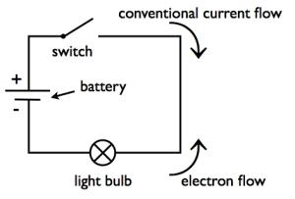
Circuit diagram

Slide 9
Circuit diagram
A battery is the power source. A circuit must start and end at the battery

Slide 10
Circuit diagram
A switch controls the flow of current. When the switch is closed, current can flow. When its open current cannot.

Slide 11
Circuit diagram
Most circuit diagrams use a light bulb as the object being powered. This can include any object from TV's to coffee makers.

Slide 12
Circuit diagram
Current flows from positive to negative.
Electrons flow from negative to positive.

Slide 13
AC vs. DC Power
Electrical power is often defined in the manner that it flows:
Alternating current (AC) flows back and forth
Direct current (DC) flows in only one direction

Slide 14
AC vs. DC Power

Slide 15
Use the worksheet provided that looks like the table below to take notes on the following video.
 | Alternating Current (AC) | Direct Current (DC)
Properties / Definition
Advantages
Disadvantages

